Slide 1

DISCRETE MATHEMATICS
Chapter 6:
GRAPH THEORY
Presenter: Ph.D. Phu-Nguyen Le
June 7th, 2023
1

Slide 2
Introduction
6.1. BASIC CONCEPTS OF GRAPHS.
    6.1.1. Undirected & directed graph.
    6.1.2. Graphical representation.
    6.1.3.Some special graphs.
6.2. PLANAR GRAPH, AND NOT FLAT.
6.2.1. Subgraph.
6.2.2. Planar graph and properties.
6.2.3. Euler's cycle and Hamiltonian cycle.
2

Slide 3
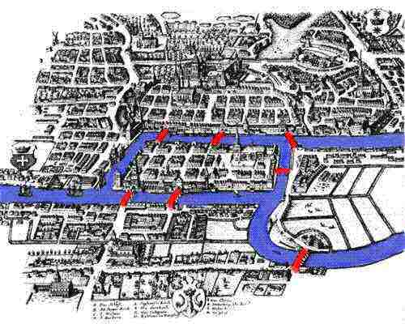
6.1 BASIC CONCEPTS OF GRAPHS
6.1.1 Undirected & directed graph
3

Slide 4
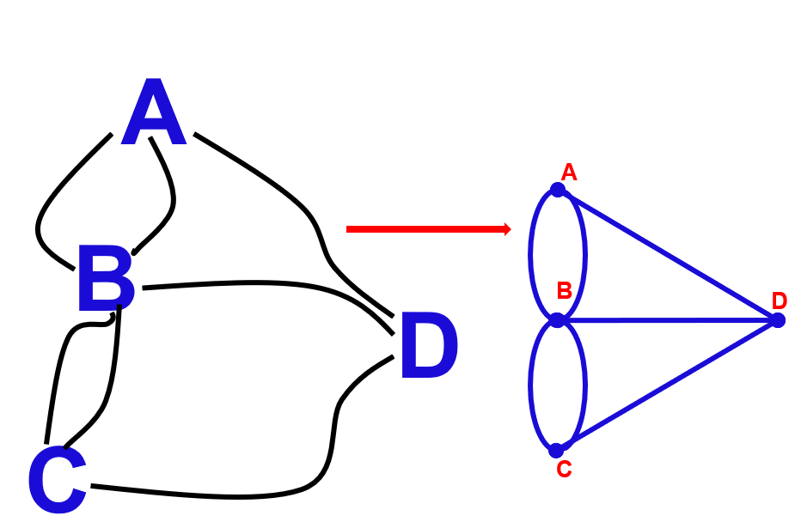
6.1 BASIC CONCEPTS OF GRAPHS
6.1.1 Undirected & directed graph
4

Slide 5
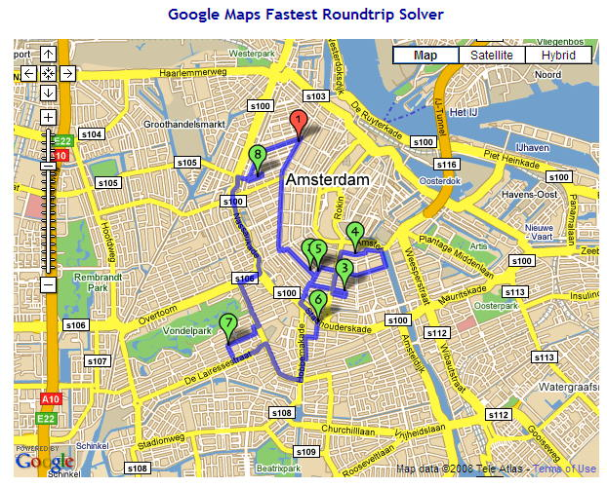
6.1 BASIC CONCEPTS OF GRAPHS
6.1.1 Undirected & directed graph
5

Slide 6
6.1 BASIC CONCEPTS OF GRAPHS
6.1.1 Undirected & directed graph
Let's assume there are 6 tasks that need to be done: A, B, C, D, E, F.
Task A: Must be done before tasks B, D.
Task B: Must be done before task D.
Task C: Must be done after task F, before A.
Task D: Must be done after tasks A, B, E.
Task E: Must be done before tasks B, D, F.
Please find a sequence to perform the tasks that satisfies the given requirements.
6

Slide 7
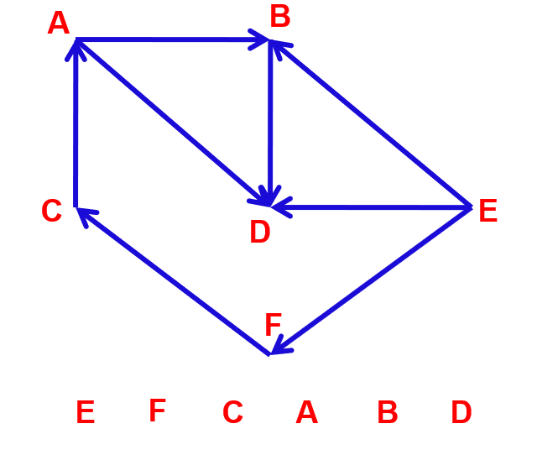
6.1 BASIC CONCEPTS OF GRAPHS
6.1.1 Undirected & directed graph
7

Slide 8
6.1 BASIC CONCEPTS OF GRAPHS
6.1.1 Undirected & directed graph
Graph theory was initiated in 1736 by Leonard Euler when he wrote a paper on the Seven Bridges of Königsberg problem.
Some notable scientists and their important contributions:
Hamilton: Hamiltonian graphs and related problems.
Dijkstra, Floyd, Warshall, Bellman: Algorithms for finding shortest paths.
Prim, Kruskal: Algorithms for finding minimum spanning trees.
8

Slide 9
6.1 BASIC CONCEPTS OF GRAPHS
6.1.1 Undirected & directed graph
In mathematics, graph theory is the study of graphs, which are mathematical structures used to model pairwise relations between objects.
A graph in this context is made up of vertices (also called nodes or points) which are connected by edges (also called links or lines).
A distinction is made between undirected graphs, where edges link two vertices symmetrically, and directed graphs, where edges link two vertices asymmetrically..
9

Slide 10
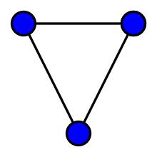
6.1 BASIC CONCEPTS OF GRAPHS
6.1.1 Undirected & directed graph
An undirected graph is an ordered pair G=(V,E) comprising:
V, a set of vertices (also called nodes or points);
E⊆{{x,y}∣x,y∈V² and x≠y} a set of edges (also called links or lines), which are unordered pairs of vertices (that is, an edge is associated with two distinct vertices).
A graph with three vertices and three edges.
10
Notes:
To avoid ambiguity, this type of object may be called precisely an undirected simple graph..

Slide 11
6.1 BASIC CONCEPTS OF GRAPHS
6.1.1 Undirected & directed graph
In the edge {x,y}, the vertices x and y are called the endpoints of the edge. The edge is said to join x and y and to be incident on x and on y.
A vertex may exist in a graph and not belong to an edge.
Multiple edges are two or more edges that join the same two vertices
A loop is an edge that joins a vertex to itself
Degree of vertex X are the number of edges connected to X
11
Notes:
To avoid ambiguity, this type of object may be called precisely an undirected simple graph..

Slide 12
6.1 BASIC CONCEPTS OF GRAPHS
6.1.1 Undirected & directed graph
Simple graph
A graph which no loop, no multiple edges
Multi-graph
A graph which is permitted to have multiple edges (also called parallel edges, that is, edges that have the same end nodes, or. Thus two vertices may be connected by more than one edge.
A graph which loop(s)
12
Notes:
To avoid ambiguity, this type of object may be called precisely an undirected simple graph..

Slide 13
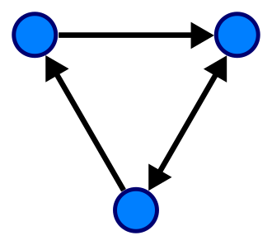
6.1 BASIC CONCEPTS OF GRAPHS
6.1.1 Undirected & directed graph
Directed graph:
A single directed graph is a set G=<V,E>,
V is a finite set of vertices of the graph.
E is the set of ordered pairs of two
different elements of V called arcs.
13
Notes:
To avoid ambiguity, this type of object may be called precisely an undirected simple graph..

Slide 14
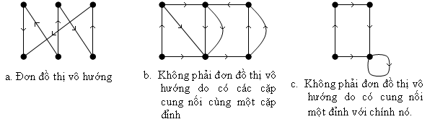
6.1 BASIC CONCEPTS OF GRAPHS
6.1.1 Undirected & directed graph
Directed graph:
14
Notes:
To avoid ambiguity, this type of object may be called precisely an undirected simple graph..

Slide 15
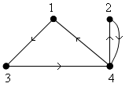
6.1 BASIC CONCEPTS OF GRAPHS
6.1.2. Graphical representation.
By adjacency matrix:
Let the graph G = <V, E>, with V = {v₁, v₂, …, v_{n}}. The adjacency matrix representing G is a square matrix A, size nxn, defined as follows:
15
Notes:
Tại sao phải biểu diễn đồ thị trên máy tính???
Lý thuyết đồ thị ngày càng được ứng dụng rộng rãi.
Để xây dựng được các ứng dụng của đồ thị trên máy tính thì cần phải tìm cách biểu diễn đồ thị trên máy tính thích hợp.
Máy tính không thể hiểu được các đồ thị dưới dạng hình vẽ thông thường.
Tiêu chuẩn để lựa chọn cách thức biểu diễn đồ thị trên máy tính?
Cấu trúc dữ liệu phải đơn giản, phù hợp với từng bài toán ứng dụng.
Dễ biểu diễn, dễ cài đặt các ứng dụng trên đó.
Ở cách biểu diễn ma trận này, ma trận sẽ không biểu diễn được:
Đồ thị có cạnh song song
Ưu điểm lớn nhất của phương pháp biểu diễn đồ thị bằng ma trận kề là để trả lời câu hỏi: Hai đỉnh u,v có kề nhau trên đồ thị hay không, chúng ta chỉ phải thực hiện một phép so sánh.
Nhược điểm lớn nhất của phương pháp này là: không phụ thuộc vào số cạnh của đồ thị, ta luôn phải sử dụng n^2 đơn vị bộ nhớ để lưu trữ ma trận kề của nó.

Slide 16
6.1 BASIC CONCEPTS OF GRAPHS
6.1.2. Graphical representation.
By adjacency matrix:
Ex:?
15
Notes:
Tại sao phải biểu diễn đồ thị trên máy tính???
Lý thuyết đồ thị ngày càng được ứng dụng rộng rãi.
Để xây dựng được các ứng dụng của đồ thị trên máy tính thì cần phải tìm cách biểu diễn đồ thị trên máy tính thích hợp.
Máy tính không thể hiểu được các đồ thị dưới dạng hình vẽ thông thường.
Tiêu chuẩn để lựa chọn cách thức biểu diễn đồ thị trên máy tính?
Cấu trúc dữ liệu phải đơn giản, phù hợp với từng bài toán ứng dụng.
Dễ biểu diễn, dễ cài đặt các ứng dụng trên đó.
Ở cách biểu diễn ma trận này, ma trận sẽ không biểu diễn được:
Đồ thị có cạnh song song
Ưu điểm lớn nhất của phương pháp biểu diễn đồ thị bằng ma trận kề là để trả lời câu hỏi: Hai đỉnh u,v có kề nhau trên đồ thị hay không, chúng ta chỉ phải thực hiện một phép so sánh.
Nhược điểm lớn nhất của phương pháp này là: không phụ thuộc vào số cạnh của đồ thị, ta luôn phải sử dụng n^2 đơn vị bộ nhớ để lưu trữ ma trận kề của nó.

Slide 17
6.1 BASIC CONCEPTS OF GRAPHS
6.1.2. Graphical representation.
By incident matrix:
Undirected graph
v_{i} vertices of e_{j}
v_{i} not vertices of e_{j}
17

Slide 18
6.1 BASIC CONCEPTS OF GRAPHS
6.1.2. Graphical representation.
By incident matrix:
Directed graph
v_{i} start point of e_{j}
v_{i} end point of e_{j}
v_{i} not a point of e_{j}
18
Notes:
Trong ma trận của đồ thị có hướng tổng bậc ra của các đỉnh = Tổng bậc vào của các đỉnh = Đỉnh.
Trong ma trận của đồ thị vô hướng tổng bậc của tất cả các đỉnh = 2 lần số cạnh.
Ưu điểm:
Đồ thị có cạnh song song
Ma trận liên thuộc đỉnh-cạnh sẽ tiết kiệm bộ nhớ hơn khi đồ thị có ít cạnh/cung.
Khuyết điểm:
Biểu diễn phức tạp

Slide 19
6.1 BASIC CONCEPTS OF GRAPHS
6.1.2. Graphical representation.
By incident matrix:
1
e₁
2
e₂
3
e₄
e₃
e₇
e₅
4
e₆
5
6
19

Slide 20
6.1 BASIC CONCEPTS OF GRAPHS
6.1.2. Graphical representation.
By incident matrix:
e₁
e₅
e₂
e₄
e₃
20

Slide 21
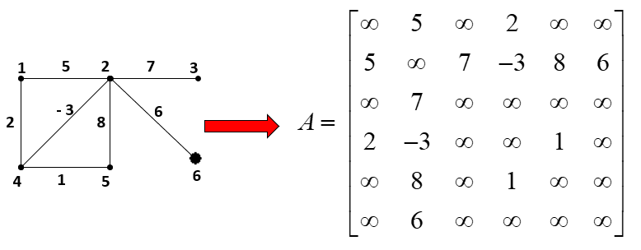
6.1 BASIC CONCEPTS OF GRAPHS
6.1.2. Graphical representation.
By weight matrix:
21
Notes:
Ở cách biểu diễn ma trận này, ma trận sẽ không biểu diễn được:
Đồ thị có cạnh song song
Ở cách biểu diễn ma trận này, ma trận có thể biểu diễn được:
Đồ thị có khuyên

Slide 22
6.1 BASIC CONCEPTS OF GRAPHS
6.1.2. Graphical representation.
By edge list
Start | End
1 | 3
4 | 1
3 | 4
4 | 2
2 | 4
e₁
e₄
e₂
e₅
e₃
22

Slide 23
6.1 BASIC CONCEPTS OF GRAPHS
6.1.2. Graphical representation.
By adjacency list
1
3
NULL
2
4
NULL
3
4
NULL
4
1
2
NULL
23

Slide 24
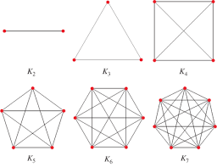

6.1 BASIC CONCEPTS OF GRAPHS
6.1.3.Some special graphs.
A complete graph is a simple undirected graph in which every pair of distinct vertices is connected by a unique edge. A complete digraph is a directed graph in which every pair of distinct vertices is connected by a pair of unique edges
24

Slide 25
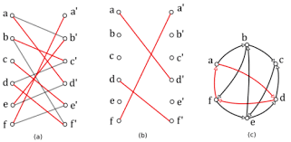
6.1 BASIC CONCEPTS OF GRAPHS
6.1.3.Some special graphs.
a bipartite graph (or bigraph) is a graph whose vertices can be divided into two disjoint and independent sets U and V, that is, every edge connects a vertex in U to one in
V. Vertex sets U and V are usually called the parts of the graph.
25

Slide 26
6.2 PLANAR, AND NOT FLAT GRAPH
6.2.1. Subgraph.
Degree of vertices: the number of edges connected to vertices
26

Slide 27
6.2 PLANAR, AND NOT FLAT GRAPH
6.2.1. Subgraph.
Degree of vertices in directed graph:
+ inner degree deg⁻
+ outer degree deg⁺
27

Slide 28
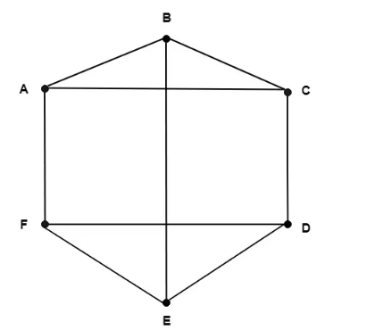
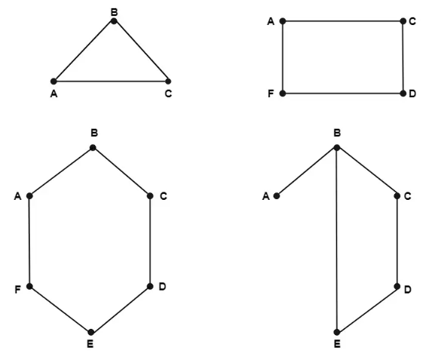
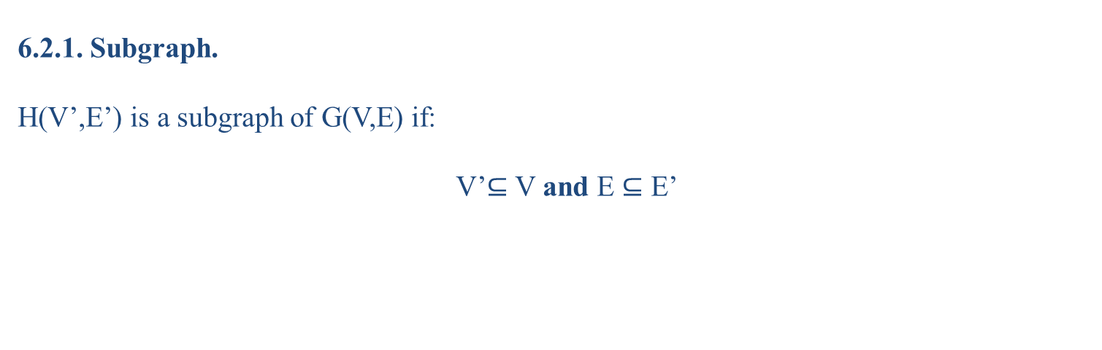
6.2 PLANAR, AND NOT FLAT GRAPH
6.2.1. Subgraph.
H(V’,E’) is a subgraph of G(V,E) if:
V’$⊆$ V and E $⊆$ E’
28

Slide 29
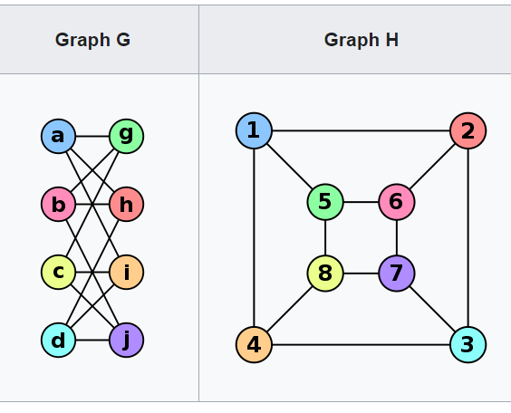
6.2 PLANAR, AND NOT FLAT GRAPH
6.2.1. Subgraph.
Isomorphism of graphs G and H is a bijection between the vertex sets of G and H:
f:V(G)→V(H)
such that any two vertices u and v of G are adjacent in G if and only if f(u) and f(v) are adjacent in H.
29
Notes:
Cùng số đỉnh.
Cùng số đỉnh bậc k, mọi k nguyên dương ≥ 0.
Cùng số cạnh.
Cùng số thành phần.

Slide 30
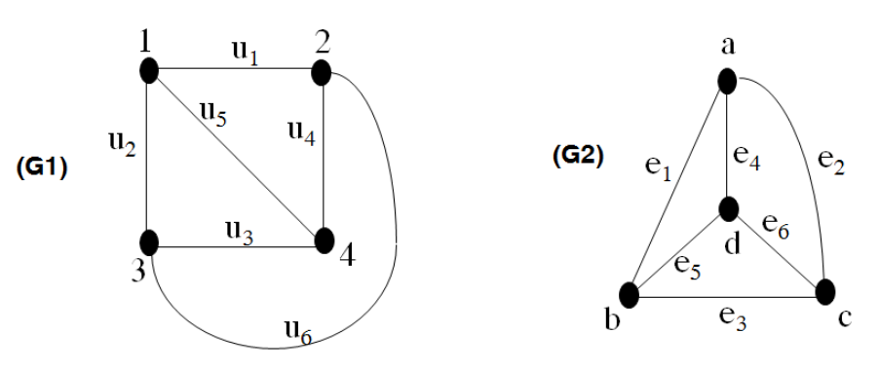
6.2 PLANAR, AND NOT FLAT GRAPH
6.2.1. Subgraph.
30

Slide 31
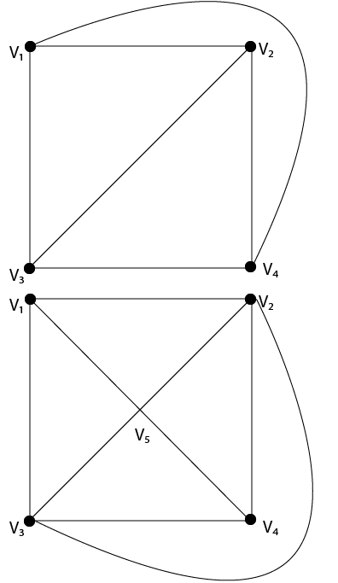
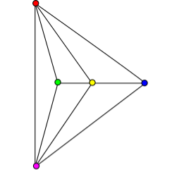
6.2 PLANAR, AND NOT FLAT GRAPH
6.2.2. Planar graph and properties.
A graph is said to be planar if it can be drawn in a plane so that no edge cross.
31

Slide 32
6.2 PLANAR, AND NOT FLAT GRAPH
6.2.2. Planar graph and properties.
Region of a Graph: Consider a planar graph G=(V,E).A region is defined to be an area of the plane that is bounded by edges and cannot be further subdivided. A planar graph divides the plans into one or more regions. One of these regions will be infinite.
Finite Region: If the area of the region is finite, then that region is called a finite region
Infinite Region: If the area of the region is infinite, that region is called a infinite region. A planar graph has only one infinite region.
32

Slide 33
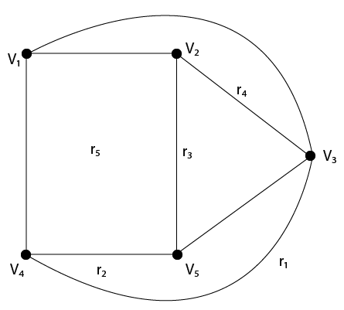
6.2 PLANAR, AND NOT FLAT GRAPH
6.2.2. Planar graph and properties.
33

Slide 34
6.2 PLANAR, AND NOT FLAT GRAPH
6.2.2. Planar graph and properties.
Properties of Planar Graphs:
  If a connected planar graph G has e edges and r regions, then r ≤ 2/3 e.
  If a connected planar graph G has e edges, v vertices, and r regions, then v-e+r=2.
  If a connected planar graph G has e edges and v vertices, then 3v-e≥6.
  A complete graph K_{n} is a planar if and only if n<5.
  A complete bipartite graph K_{mn} is planar if and only if m<3 or n>3.
34

Slide 35
6.2 PLANAR, AND NOT FLAT GRAPH
6.2.3 Euler's cycle and Hamiltonian cycle.
Path
For a graph G=(X, U).
A path in G is a sequence alternating between vertices and edges: x₁ u₁ x₂ u₂... x_{m-1} u_{m-1}1 x_{m} (x_{i} is a vertex and u_{i} is an edge) in the graph that satisfies the condition that u_{i} connects the vertex pair (x_{i}, x_{i+1}),
u_{i}=(x_{i}, x_{i+1}) if the graph is directed,
u_{i}={x_{i}, x_{i+1}} if the graph is undirected.
In this case, x₁ is called the starting vertex and x_{m} is the ending vertex of the path.
The "single" nature of a chain or path requires that no border appear twice in the path.
The "primary" (aka "secondary") quality requires that no vertices appear twice.
35

Slide 36
6.2 PLANAR, AND NOT FLAT GRAPH
6.2.3 Euler's cycle and Hamiltonian cycle.
Cycle
A path that starts and ends at the same point (k>=3) is called a cycle.
Connectivity
In an undirected graph G, two vertices u and v are called connected if G contains a path from u to v. Otherwise, they are called disconnected.
If the two vertices are additionally connected by a path of length 1, i.e. by a single edge, the vertices are called adjacent.
A graph is said to be connected if every pair of vertices in the graph is connected.
An undirected graph that is not connected is called disconnected.
An undirected graph G is therefore disconnected if there exist two vertices in G such that no path in G has these vertices as endpoints.
36

Slide 37
6.2 PLANAR, AND NOT FLAT GRAPH
6.2.3 Euler's cycle and Hamiltonian cycle.
A graph with just one vertex is connected.
An edgeless graph with two or more vertices is disconnected.
A directed graph is called weakly connected if replacing all of its directed edges with undirected edges produces a connected (undirected) graph.
It is unilaterally connected or unilateral (also called semi-connected) if it contains a directed path from u to v or a directed path from v to u for every pair of vertices u, v.
It is strongly connected, or simply strong, if it contains a directed path from u to v and a directed path from v to u for every pair of vertices u, v.
37

Slide 38
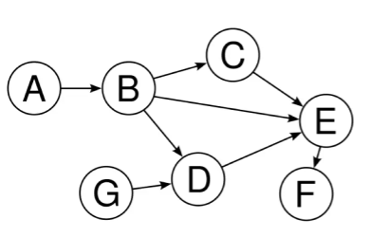
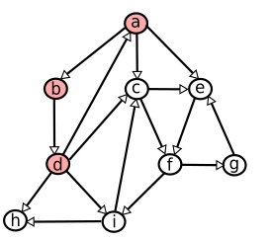
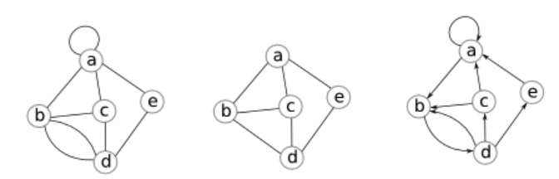
6.2 PLANAR, AND NOT FLAT GRAPH
6.2.3 Euler's cycle and Hamiltonian cycle.
38

Slide 39
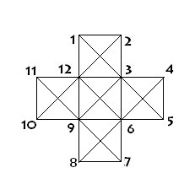
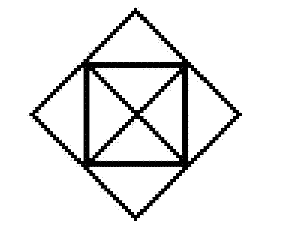
6.2 PLANAR, AND NOT FLAT GRAPH
6.2.3 Euler's cycle and Hamiltonian cycle.
Euler's cycle
Draw the following shapes with a single pen stroke (do not lift the pen while drawing).
39
Notes:
Không vẽ được bằng 1 nét. Tối thiểu phải vẽ bằng 2 nét.
Không vẽ được bằng 1 nét. Tối thiểu phải vẽ bằng 6 nét.

Slide 40
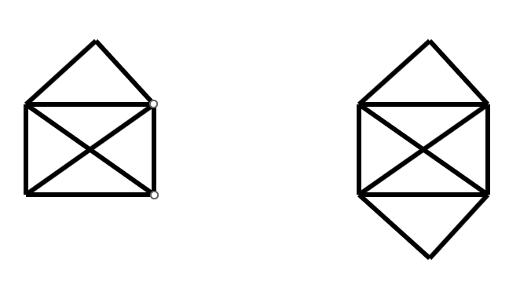
6.2 PLANAR, AND NOT FLAT GRAPH
6.2.3 Euler's cycle and Hamiltonian cycle.
Euler's cycle
Draw the following shapes with a single pen stroke (do not lift the pen while drawing).
40

Slide 41
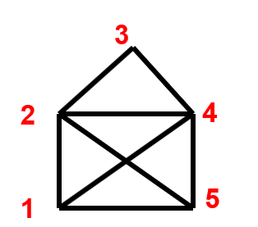
6.2 PLANAR, AND NOT FLAT GRAPH
6.2.3 Euler's cycle and Hamiltonian cycle.
Euler's cycle
Consider the graph G = <V,E>.
A path on the graph is called an Eulerian path if it traverses all edges, each edge once.
An Eulerian cycle on the graph is a cycle that goes through all edges, each edge once
EX.:
Eulerian path :
d1: 1 2 3 4 2 5 4 1 5
d2: 1 2 4 3 2 5 1 4 5
41

Slide 42
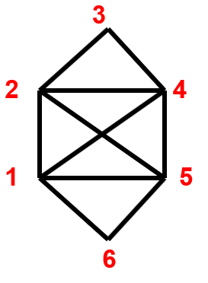
6.2 PLANAR, AND NOT FLAT GRAPH
6.2.3 Euler's cycle and Hamiltonian cycle.
Euler's cycle
Eulerian cycles :
c1: 1 2 3 4 2 5 4 1 5 6 1
c2: 1 2 4 3 2 5 1 4 5 6 1
42

Slide 43
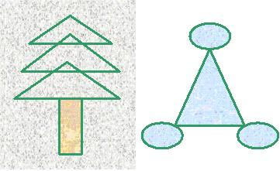
6.2 PLANAR, AND NOT FLAT GRAPH
6.2.3 Euler's cycle and Hamiltonian cycle.
Euler's cycle / Euler’s path
43
Notes:
Euler's cycle / Euler’s path

Slide 44
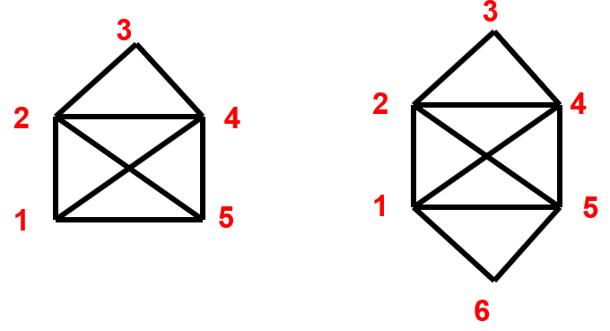
6.2 PLANAR, AND NOT FLAT GRAPH
6.2.3 Euler's cycle and Hamiltonian cycle.
A graph is called an Eulerian graph if an only if exist an Eulerian cycle in the graph
A graph is called a half Eulerian graph if an only if exist an Eulerian path in the graph
44
Notes:
Euler's cycle / Euler’s path

Slide 45
6.2 PLANAR, AND NOT FLAT GRAPH
6.2.3 Euler's cycle and Hamiltonian cycle.
Theorem. A connected undirected graph G is an Eulerian graph if and only if every vertex of it has an even degree.
Corollary. A connected undirected graph G is a semi-Eulerian graph if and only if it has at most two vertices with odd degrees.
45
Notes:
Euler's cycle / Euler’s path

Slide 46
6.2 PLANAR, AND NOT FLAT GRAPH
6.2.3 Euler's cycle and Hamiltonian cycle.
Theorem: Consider G to be a strongly connected directed graph. Then, G is an Eulerian graph if and only if every vertex of G has an equal out-degree and in-degree
46
Notes:
Euler's cycle / Euler’s path

Slide 47
6.2 PLANAR, AND NOT FLAT GRAPH
6.2.3 Euler's cycle and Hamiltonian cycle.
Find the Eulerian cycle:
Rule 1: After pass any edge, delete it
Rule 2: Only pass a bridge if there is no other choice
47
Notes:
Euler's cycle / Euler’s path

Slide 48
6.2 PLANAR, AND NOT FLAT GRAPH
6.2.3 Euler's cycle and Hamiltonian cycle.
Step | Vertex | List edges to the vertex | Edge | Bridge? Other choice? | Delete
1 | 1 | (1,2); (1,4);(1,5);(1,6) | (1,2) | N | (1,2)
2 | 2 | (2,3);(2,4);(2;5) | (2,3) | N | (2,3)
3 | 3 | (3,4) | (3,4) | Y, N | (3,4)
4 | 4 | (4,2);(4,1);(4,5) | (4,1) | N | (4,1)
5 | 1 | (1,5);(1;6) | (1,5) | N | (1,5)
6 | 5 | (5,2); (5,6) | (5,2) | N | (5,2)
7 | 2 | (2,4) | (2,4) | Y,N | (2,4)
8 | 4 | (4,5) | (4,5) | Y,N | (4,5)
9 | 5 | (5,6) | (5,6) | Y,N | (5,6)
10 | 6 | (6,1) | (6,1) | Y,N | (6,1)
11 | 1
48
Notes:
Euler's cycle / Euler’s path

Slide 49
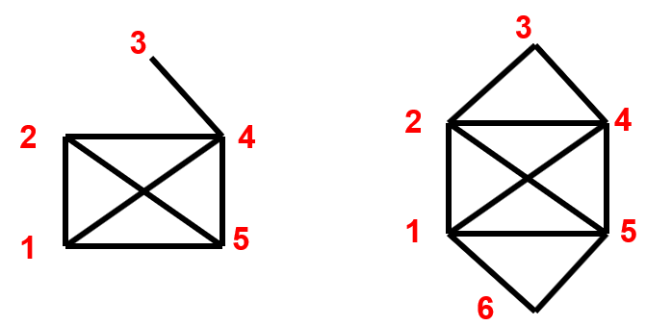
6.2 PLANAR, AND NOT FLAT GRAPH
6.2.3 Euler's cycle and Hamiltonian cycle.
Hamiltonian cycle
Consider the graph G = <V,E>.
The graph G is called a Hamiltonian graph if and only if there exists a Hamiltonian cycle in G.
The graph G is called a semi-Hamiltonian graph if and only if there exists a Hamiltonian path in G
49
Notes:
Euler's cycle / Euler’s path

Slide 50
6.2 PLANAR, AND NOT FLAT GRAPH
6.2.3 Euler's cycle and Hamiltonian cycle.
Hamiltonian cycle
Theorem (Dirac, 1952). Consider G to be an undirected simple graph with n vertices (n > 2). If every vertex of G has a degree of at least n/2, then G is a Hamiltonian graph.
Theorem (Dirac, 1952). Consider G to be a strongly connected directed simple graph with n vertices (n > 2). If every vertex of G has an out-degree and in-degree of at least n/2, then G is a Hamiltonian graph
Theorem (Ore, 1960): For a graph G with n vertices. If any two non-adjacent vertices of G have a sum of degrees at least n, then G is a Hamiltonian graph. In other words:
50
Notes:
Euler's cycle / Euler’s path

Slide 51
6.2 PLANAR, AND NOT FLAT GRAPH
6.2.3 Euler's cycle and Hamiltonian cycle.
Hamiltonian cycle
Rules for determining Hamiltonian cycles (H) in a graph:
Rule 1: If there is a vertex of degree 2, then both edges of this vertex must be included in H.
Rule 2: There should not be any subcycle (of length less than n) within H.
Rule 3: For a particular vertex, if you have already selected both incoming edges into H, then you must remove all other remaining edges (since you can't add more).
No isolated vertices or pendant vertices exist when applying rule 3.
51
Notes:
Euler's cycle / Euler’s path

Slide 52
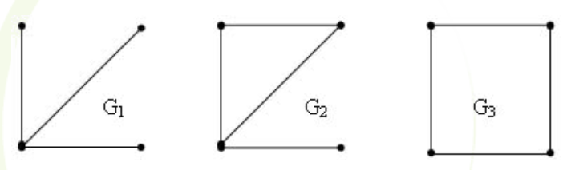
6.2 PLANAR, AND NOT FLAT GRAPH
6.2.3 Euler's cycle and Hamiltonian cycle.
Hamiltonian cycle
52
Notes:
Euler's cycle / Euler’s path

Slide 53
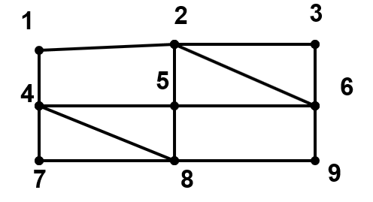
6.2 PLANAR, AND NOT FLAT GRAPH
6.2.3 Euler's cycle and Hamiltonian cycle.
Hamiltonian cycle
53
Notes:
Euler's cycle / Euler’s path

Slide 54
Section 3, and 4
6.3. TREE AND FOREST.
6.3.1. Definition
6.3.2. Rooted tree.
6.3.3. Minimal spanning tree.
6.4. MATH PROBLEMS
6.4.1. Shortest path problem.
6.4.2 Graph coloring.
54

Slide 55
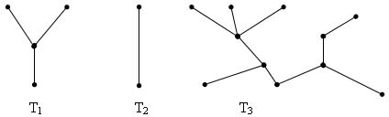
6.3. TREE AND FOREST
6.3.1. Definition
A tree is a single undirected, connected graph that contains no cycles.
Example: Which of the following graphs is a tree?
55
Notes:
Euler's cycle / Euler’s path

Slide 56
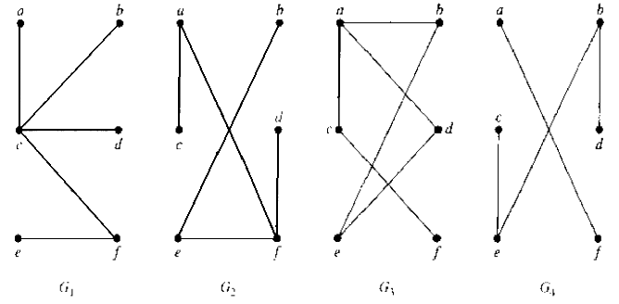
6.3. TREE AND FOREST
6.3.1. Definition
A tree is a single undirected, connected graph that contains no cycles.
Example: Which of the following graphs is a tree?
56
Notes:
Euler's cycle / Euler’s path

Slide 57
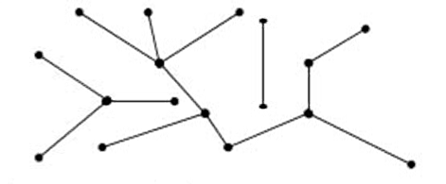
6.3. TREE AND FOREST
6.3.1. Definition
If G is an undirected graph and contains no cycles, then G is said to be a forest. Then each connected component of G will be a tree.
Example: The following graph is a forest with three tree
57
Notes:
Euler's cycle / Euler’s path

Slide 58
6.3. TREE AND FOREST
6.3.1. Definition
Theorem:
Let T be an undirected graph. Then the following are equivalent:
  T is a tree.
  T contains no cycles and has n – 1 edges.
  T is connected and has n - 1 edges.
  T is connected and every edge of T is a cutting edge (bridge).
  Any two vertices of T are connected by exactly one single path.
  T does not contain a cycle, but if we add any edge to T, we will get exactly 1 cycle.
58
Notes:
Euler's cycle / Euler’s path

Slide 59
6.3. TREE AND FOREST
6.3.2. Rooted tree:
In some trees, a particular vertex is chosen as the root
The path from the origin to the vertices is oriented from the origin to that vertex
It follows that a tree with a root will produce a directed graph, which is called a rooted tree.
59
Notes:
Euler's cycle / Euler’s path

Slide 60
6.3. TREE AND FOREST
6.3.2. Rooted tree:
A rooted tree is a tree with a special vertex labelled as the "root" the of tree.
The root serves as a point of reference for other vertices in the tree. In diagrams, we usually keep the root at the top and list other vertices below it.
This notion is particularly useful in computer science for working with tree-based data structures.
In the figure, the root vertex is shown with a black border.
Below are some useful terms associated with rooted trees.
60
Notes:
Euler's cycle / Euler’s path

Slide 61
6.3. TREE AND FOREST
6.3.2. Rooted tree:
In a rooted tree:
Each vertex has only one parent – the vertex that goes directly to it on the path from the root
Each vertex may have zero, one or more child vertices
Vertices with children are called inner vertices, vertices without children are called outer vertices (leaf nodes)..
61
Notes:
Euler's cycle / Euler’s path

Slide 62
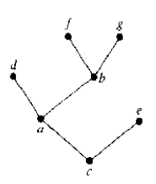
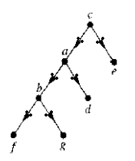
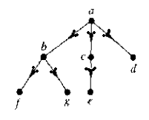
6.3. TREE AND FOREST
6.3.2. Rooted tree:
62
Notes:
Euler's cycle / Euler’s path

Slide 63
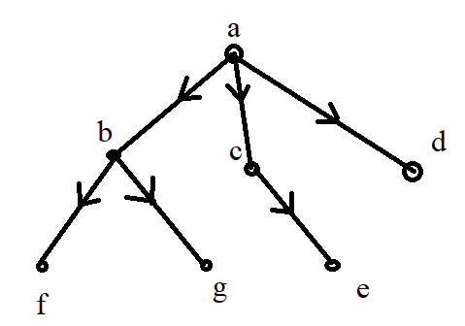
6.3. TREE AND FOREST
6.3.2. Rooted tree:
The vertex a is the original vertex
The child vertices of vertex a: b, c and d.
Parent vertex of vertex f: vertex b (unique)
Inner Vertices: a, b, and c.
The outer vertices (leaves): f, k, e and d.
63
Notes:
Euler's cycle / Euler’s path

Slide 64
6.3. TREE AND FOREST
6.3.2. Rooted tree:
A rooted tree is said to be an m-partition tree if all its interior vertices have no more than m sub-vertices.
A tree is said to be m-partially complete if all its interior vertices have exactly m sub-vertices
With m = 2, we have a binary tree.
An ordered rooted tree is a rooted tree in which the children of each vertex are always arranged in some order (usually growing from left to right).
64
Notes:
Euler's cycle / Euler’s path

Slide 65
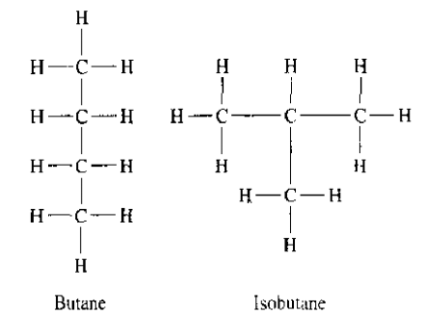
6.3. TREE AND FOREST
6.3.2. Rooted tree:
Give more examples?
65
Notes:
Euler's cycle / Euler’s path

Slide 66
6.3. TREE AND FOREST
6.3.2. Rooted tree:
Binary search tree (learned in CTDL)
Decision tree.
  Is a tree with roots
  Each vertex corresponds to a decision
  Each subtree at this vertex corresponds to the possible outcomes of that decision
66
Notes:
Euler's cycle / Euler’s path

Slide 67
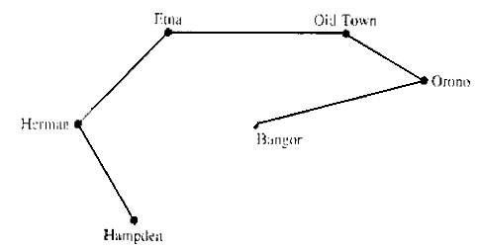
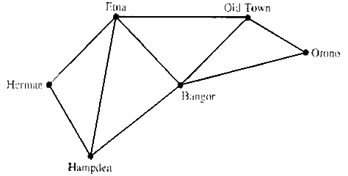
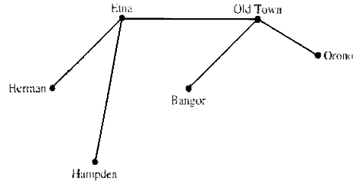
6.3. TREE AND FOREST
6.3.2. Rooted tree:
The road system in Maine is as shown below.
  Snow is covering all the roads.
  Need to restore the system by shoveling some roads.
  It is not necessary to shovel all the roads:
67
Notes:
Euler's cycle / Euler’s path

Slide 68
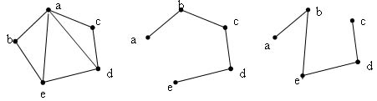
6.3. TREE AND FOREST
6.3.3. Minimal spanning tree:
Let G be a simple graph. A tree T is said to be a minimal spanning tree of G if and only if:
  T is a subgraph of G
  T contains all vertices of G
68
Notes:
Euler's cycle / Euler’s path

Slide 69
6.3. TREE AND FOREST
6.3.3. Minimal spanning tree:
Theorem:
A simple graph is connected if and only if it has a spanning tree.
Prove:
If G contains a spanning tree, then the spanning tree is connected and the spanning tree contains all the vertices of G. It follows that the vertices of G are always connected or G is connected.
Consider G connected. Assuming there is a cycle in G, delete an edge in this cycle, then the graph is still connected. If there is still a cycle, repeat the above step. Keep doing this until there are no more cycles. Then we will get a frame
69
Notes:
Euler's cycle / Euler’s path

Slide 70
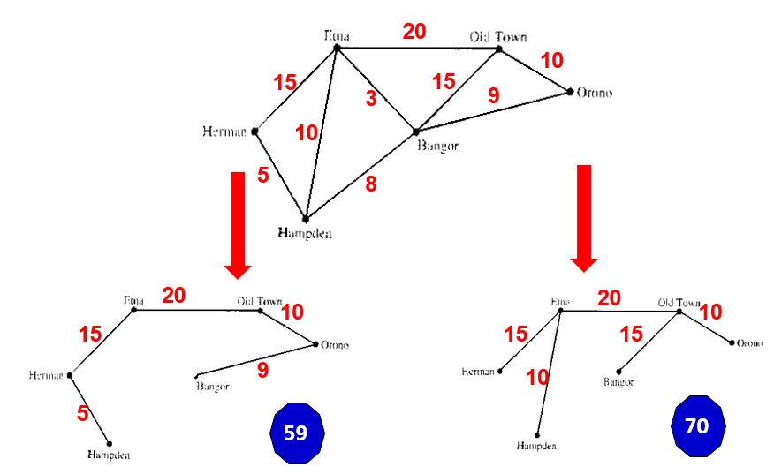
6.3. TREE AND FOREST
6.3.3. Minimal spanning tree:
Minimal spanning tree problem:
70
Notes:
Euler's cycle / Euler’s path

Slide 71
6.3. TREE AND FOREST
6.3.3. Minimal spanning tree:
Minimal spanning tree problem:
Define.
Given a weighted graph G. The smallest spanning tree of G (if exists) is the spanning tree with the smallest weight sum among the spanning trees of G.
Algorithms to find the smallest spanning tree:
Kruskal Algorithm
Prim Algorithm
71
Notes:
Euler's cycle / Euler’s path

Slide 72
6.3. TREE AND FOREST
6.3.3. Minimal spanning tree:
Kruskal Algorithm:
Consider the edges in order of increasing weight
For each edge under consideration, we try to put it in the tree of frames T:
If there is no cycle with the selected edges, accept this new edge and put it in the tree.
If forming a cycle with selected edges, skip and consider the next edge.
Continue like this until you find enough n-1 edges to put in the tree T
72
Notes:
Euler's cycle / Euler’s path

Slide 73
6.3. TREE AND FOREST
20
10
15
15
3
9
10
5
8
Etna
Oldtown
10
3
Hermae
9
Orono
5
8
Bangor
Hampden
73

Slide 74
6.3. TREE AND FOREST
2
4
2
4
20
33
8
8
1
18
16
9
6
1
18
9
6
17
14
17
3
4
5
3
4
5
Weight | Edge
4 | (3,5)
8 | (4,6)
9 | (4,5)
14 | (5,6)
16 | (3,4)
17 | (1,3)
18 | (2,3)
20 | (2,4)
33 | (1,2)
Select
Select
Select
Not Select
Not Select
Select
Select. Stop for n-1 condition.
74

Slide 75
6.3. TREE AND FOREST
6.3.3. Minimal spanning tree:
Prim Algorithm:
Starting from any vertex. Put this vertex in the T-frame tree.
At each step, always choose the least weighted edge among the edges that adjacency to a vertex in T (the other vertex is outside T).
Insert the newly selected edge and its vertex into the T tree
Repeat the above process until enough n-1 edges are included in T
75
Notes:
Euler's cycle / Euler’s path

Slide 76
6.3. TREE AND FOREST
20
10
15
15
3
9
10
5
8
Etna
Oldtown
10
3
Hermae
9
Orono
5
8
Bangor
Hampden
76

Slide 77
6.3. TREE AND FOREST
2
4
2
4
20
33
8
8
1
18
16
9
6
1
18
9
6
17
14
17
3
4
5
3
4
5
Step | Vertex | Adjacency vertex/weight | Select | Edge
1 | 1 | [2/33] [3/17] | 3 | (1,3)
1 | 1,3 | [2/33] [2/18] [4/16][5/4] | 5 | (3,1),(5,3)
2 | 1,3,5 | [2/33] [2/18] [4/16][4/9] [6/14] | 4 | (3,1),(5,3),(4.5)
3 | 1,3,5,4 | [2/33] [2/18][2/20] [6/8] [6/14] | 6 | (3,1),(5,3),(4.5) (6,4)
4 | 1,3,5,4,6 | [2/33] [2/18][2/20] | 2 | (3,1),(5,3),(4.5) (6,4),(2,3)
5 | 1,3,5,4,6,2 | -
77

Slide 78

6.3. MATH PROBLEMS
6.3.3. Shortest path problem
To find shortest path from a to z vertex
Initial step: $L(a)=0$, S=∅, for every vertex v that $v≠a,$ $L(v)=∞$
Stop condition: $z∈S$, L(z) is the minimum path from a to z
Find the next vertex: Find $v∈V (v∉S)$ for L(v) is minimum
Label the vertex: For x vertex that is adjacency to y but not belong to S
$L(x)=min⁡\{L(x),L(v)+w(v,x)\}$
5. Back to 2.
78

Slide 79
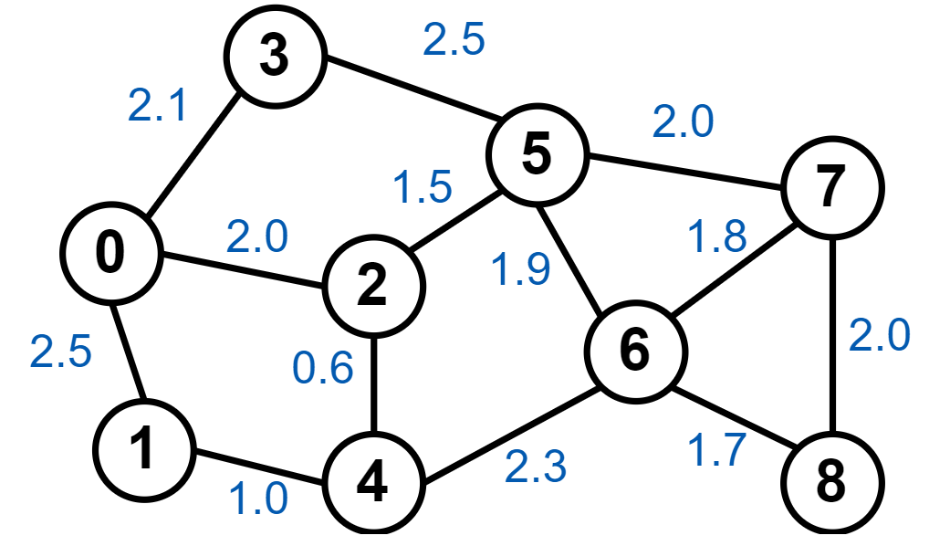
6.3. MATH PROBLEMS
6.3.3. Shortest path problem
78

Slide 80
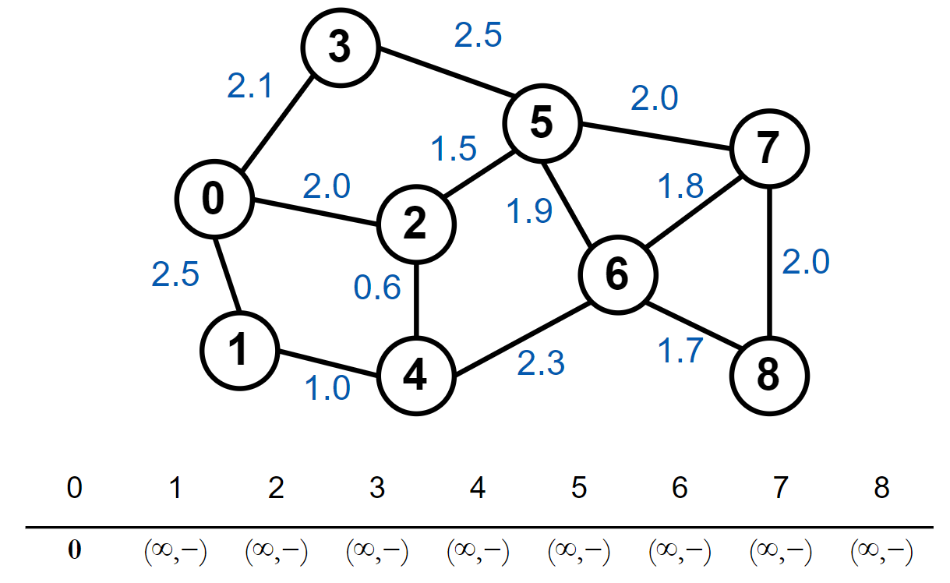
6.3. MATH PROBLEMS
6.3.3. Shortest path problem
78
Notes:
Đầu tiên, khởi tạo khoảng cách nhỏ nhất ban đầu tới các đỉnh khác là
+∞ và khoảng cách tới đỉnh gốc là 0. Ta được danh sách các khoảng cách tới các đỉnh.

Slide 81
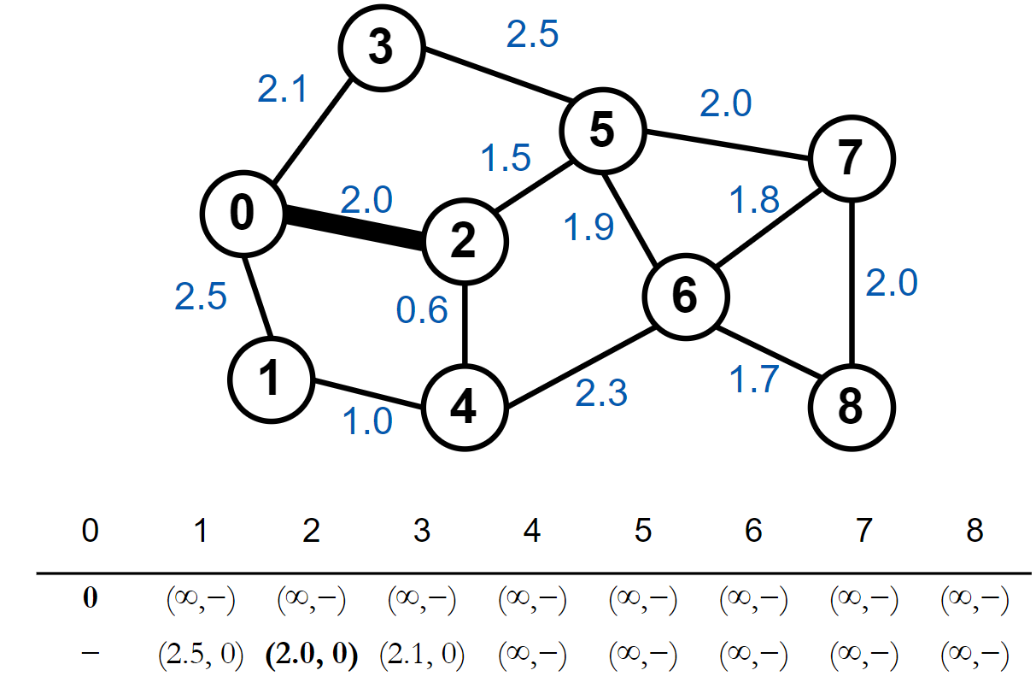
6.3. MATH PROBLEMS
6.3.3. Shortest path problem
78
Notes:
Chọn đỉnh 0 có giá trị nhỏ nhất, xét các đỉnh kề của đỉnh 0:
Xét đỉnh 1, khoảng cách từ gốc đến đỉnh 1 là 2.5 < ∞
nên ghi nhận giá trị mới là (2.5,0)
(2.5,0) (nghĩa là khoảng cách đến đỉnh gốc hiện tại ghi nhận là 2.5, đỉnh kề liền trước là đỉnh 0).

Slide 82
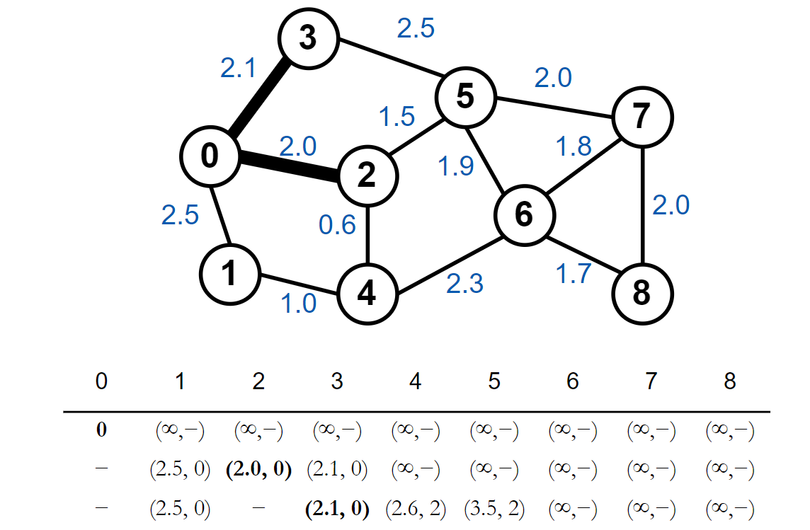
6.3. MATH PROBLEMS
6.3.3. Shortest path problem
78
Notes:
Xét tương tự cho đỉnh 2 và 3, ta được dòng thứ 2 trong bảng
Sau khi xét tất cả các đỉnh ta chọn đỉnh 2 có khoảng cách nhỏ nhất và ghi nhận để xét tiếp.
Tiếp tục xét đỉnh kề của 2 là đỉnh 4 và 5 với nguyên tắc nêu ở trên.
Xét đỉnh 4, khoảng cách từ đỉnh gốc đến đỉnh 4 sẽ bằng khoảng cách từ đỉnh gốc tới đỉnh 2 cộng khoảng cách từ 2 đến 4.
Nghĩa là 2.0+0.6=2.6 nên ta ghi nhận khoảng cách tại đỉnh 4 là (2.6,2). Xét tương tự cho đỉnh 5.

Slide 83

6.3. MATH PROBLEMS
6.3.3. Shortest path problem
78
Notes:
Lúc này ta chọn được đỉnh 3 có khoảng cách nhỏ nhất,
xét đỉnh kề của đỉnh 3 là đỉnh 5.
Khoảng cách từ gốc tới đỉnh 5 =2.1+2.5=4.6
lớn hơn khoảng cách hiện tại được ghi nhận, vì vậy giá trị tại đỉnh 5 không đổi.
Đỉnh 1 là đỉnh được chọn tiếp theo, xét đỉnh kề của 1 là đỉnh 4.
Khoảng cách từ đỉnh gốc không nhỏ hơn khoảng cách hiện tại nên ta không cập nhật gì ở đỉnh này.

Slide 84


6.3. MATH PROBLEMS
6.3.3. Shortest path problem
78
Notes:
Sau khi xét xong ta chọn được đỉnh 4 là đỉnh tiếp theo. Ta cập nhật giá trị mới cho đỉnh 6.

Slide 85


6.3. MATH PROBLEMS
6.3.3. Shortest path problem
78
Notes:
Chọn được đỉnh 5 là đỉnh nhỏ nhất, tiếp tục xét các đỉnh kề.

Slide 86


6.3. MATH PROBLEMS
6.3.3. Shortest path problem
78
Notes:
Đỉnh 6 là đỉnh tiếp theo được chọn.

Slide 87


6.3. MATH PROBLEMS
6.3.3. Shortest path problem
78
Notes:
Chọn đỉnh có khoảng cách nhỏ nhất là đỉnh 7.
Thuật toán kết thúc khi chọn được khoảng cách nhỏ nhất cho tất cả các đỉnh.

Slide 88

6.3. MATH PROBLEMS
6.4.2 Graph coloring.
77

Slide 89





6.3. MATH PROBLEMS
6.4.2 Graph coloring.
3 colors
4 colors
?
77

Slide 90

6.3. MATH PROBLEMS
6.4.2 Graph coloring.
77

Slide 91
6.3. MATH PROBLEMS
6.4.2 Graph coloring.
1
2
7
8
4
7
1
2
8
6
4
3
9
3
6
9
5
5
2
6
2
5
6
1
4
5
1
4
3
7
3
7
77

Slide 92

6.3. MATH PROBLEMS
6.4.2 Graph coloring.
Theorem 1: Every odd cycle has a chromatic number of 3
Theorem 2: If G contains an isomorphic subgraph with K_{n}then 𝜒(𝐺) ≥ n.
Theorem 3: A single graph G = (V, E) can be filled with 2color if and only if it has no cycles of odd length.
Theorem 4: If a graph has n vertices then 𝜒(𝐺) ≤ n
Theorem 5: For all graphs G: 𝜒(𝐺) ≤ 1+max(deg(v)) (v$∈$ V)
Theorem 6: If G is a connected graph, there are no cycles odd graph, not a complete graph, then 𝜒(𝐺) ≤ 1+max(deg(v)) (v$∈$ V)
77

Slide 93
6.3. MATH PROBLEMS
6.4.2 Graph coloring.
Any planar graph can be colored by no more than 4 colors.
The W-P algorithm is used to color a graph G
  Step 1: Arrange the vertices G in descending order.
  Step 2: Use an unpainted color to paint the first vertex in the list book and all non-adjacent vertices, k adjacent to the first vertex.
  Step 3: Remove colored vertices
  Step 4:- If you have finished coloring: finished
  - If not done: go back to step 2
77

Slide 94

6.3. MATH PROBLEMS
6.4.2 Graph coloring.
77

Slide 95
6.3. MATH PROBLEMS
6.4.2 Graph coloring.
Vertex | Deg
A | 2
B | 5
C | 3
D | 2
E | 2
F | 5
G | 3
H | 3
I | 4
J | 1
K | 2
77

Slide 96

6.3. MATH PROBLEMS
6.4.2 Graph coloring.
Use red to paint vertex B
  Paint k adjacent vertices B: D, I
  Remove vertices B, D, I
Use blue color to fill the vertex F
  Paint the vertices H, A, K, J
  Remove vertices F, H, A, K, J
Use yellow to paint vertex C
  Paint vertices E, G, K
Finished coloring => finished
77

Slide 97


6.3. MATH PROBLEMS
6.4.2 Graph coloring.
77

Slide 98
6.3. MATH PROBLEMS
6.4.2 Graph coloring.
Applications:
  pattern matching
  sports scheduling,
  designing seating plans,
  exam timetabling,
  the scheduling of taxis,
  solving Sudoku puzzles
77

Slide 99
THANK YOU!

